Slide 1
Bayesian Decision Theory
An Introduction
By : Arya Rajiv Chaloli

Slide 2
ABSTRACT
ABSTRACT
Introduction
The Decision Rule
Minimum Error rate classification

Slide 3
INTRODUCTION
INTRODUCTION
Fundamental statistical approach
Uses probability of taking a decision and the costs that accompany such decisions.
It makes the assumption that the decision problem is posed in probabilistic terms, and that all of the relevant probability values are known.

Slide 4
PRIORI PROBABILITY
INTRODUCTION
Or prior
These prior probabilities reﬂect our prior knowledge of how likely we are to get a particular result before it actually appears. It might depend on various external factors
It is represented as P(ω_{i})

Slide 5
THE DECISION RULE – PART 1
THE DECISION RULE
Decide ω1 if P(ω1) >P(ω2); otherwise decide ω2.
In general, the probability of error is the smaller of P(ω1) and P(ω2)

Slide 6
THE DECISION RULE – PART 2
THE DECISION RULE
The probability of x being the feature value when the event w1 has occurred is expressed as p(x|ω1).
the likelihood of ωj with respect to x
The probability of w1 being the event when the feature value is x is expressed as p(x|ω1).
posteriori probability or posterior

Slide 7
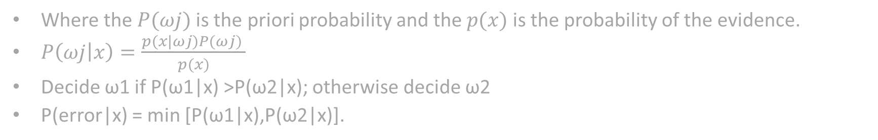
THE DECISION RULE – PART 2
THE DECISION RULE
Where the $P(ωj)$is the priori probability and the $p(x)$ is the probability of the evidence.
$P\left(ωj | x\right)=\frac{p(x|ωj)P(ωj) }{p(x)}$
Decide ω1 if P(ω1|x) >P(ω2|x); otherwise decide ω2
P(error|x) = min [P(ω1|x),P(ω2|x)].

Slide 8
THE DECISION RULE – PART 3
THE DECISION RULE
an expected loss is called a risk
R(αi|x) is called the conditional risk.
Whenever we encounter a particular observation x, we can minimize our expected loss by selecting the action that minimizes the conditional risk.

Slide 9
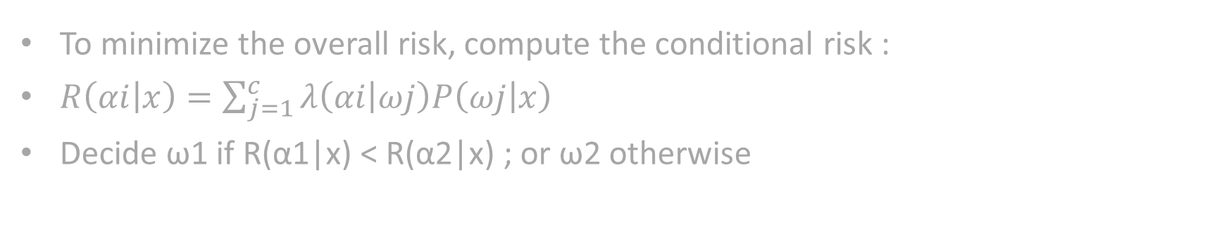
THE DECISION RULE – PART 3
THE DECISION RULE
To minimize the overall risk, compute the conditional risk :
$R\left(αi | x\right)=\sum_{j=1}^{c}{λ\left(αi | ωj\right)P\left(ωj | x\right) }$
Decide ω1 if R(α1|x) < R(α2|x) ; or ω2 otherwise

Slide 10
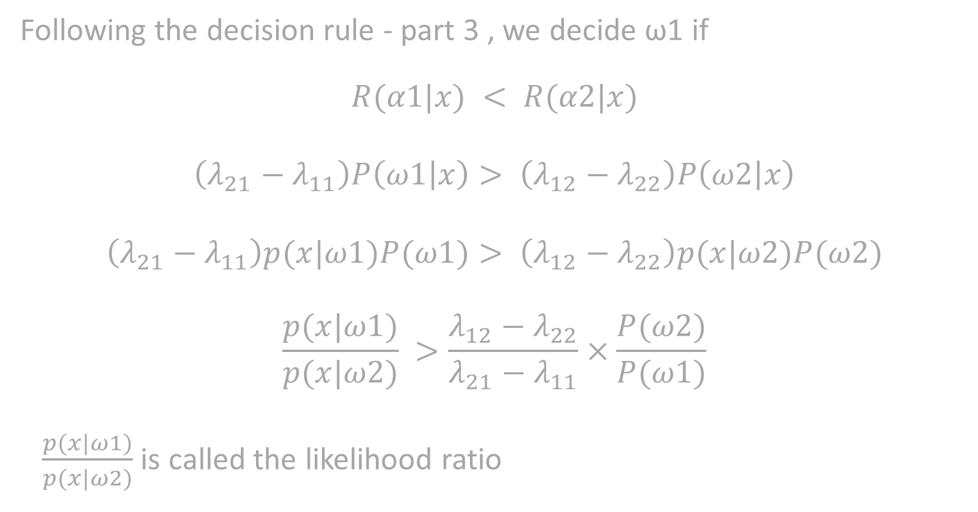
Following the decision rule - part 3 , we decide ω1 if
$$R(α1|x) < R(α2|x)$$
$$\left(λ_{21}−λ_{11}\right)P\left(ω1 | x\right)> \left(λ_{12}−λ_{22}\right)P\left(ω2 | x\right)$$
$$\left(λ_{21}−λ_{11}\right)p(x|ω1)P(ω1)> \left(λ_{12}−λ_{22}\right)p(x|ω2)P(ω2)$$
$$\frac{p(x|ω1)}{p(x|ω2)} >\frac{λ_{12}−λ_{22}}{λ_{21}−λ_{11}}×\frac{P(ω2)}{P(ω1)}$$
$\frac{p(x|ω1)}{p(x|ω2)}$ is called the likelihood ratio

Slide 11
BAYES RISK
THE DECISION RULE
Bayes risk is the minimum overall risk.
It is denoted by R*.
Itis the best performance that can be achieved.
It is obtained from the Decision rule part 3

Slide 12
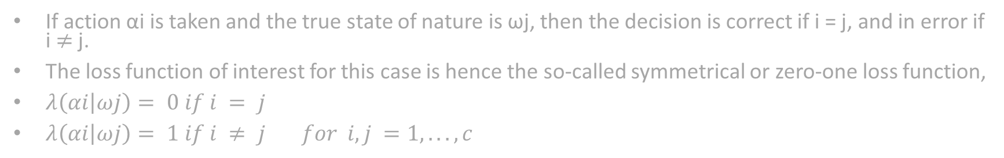
ZERO – ONE LOSS
MINIMUM ERROR RATE CLASSIFICATION
If action αi is taken and the true state of nature is ωj, then the decision is correct if i = j, and in error if i$≠$ j.
The loss function of interest for this case is hence the so-called symmetrical or zero-one loss function,
$λ\left(αi | ωj\right)= 0 if i = j$
$λ\left(αi | ωj\right)= 1 if i ≠ j for i,j =1,...,c$

Slide 13
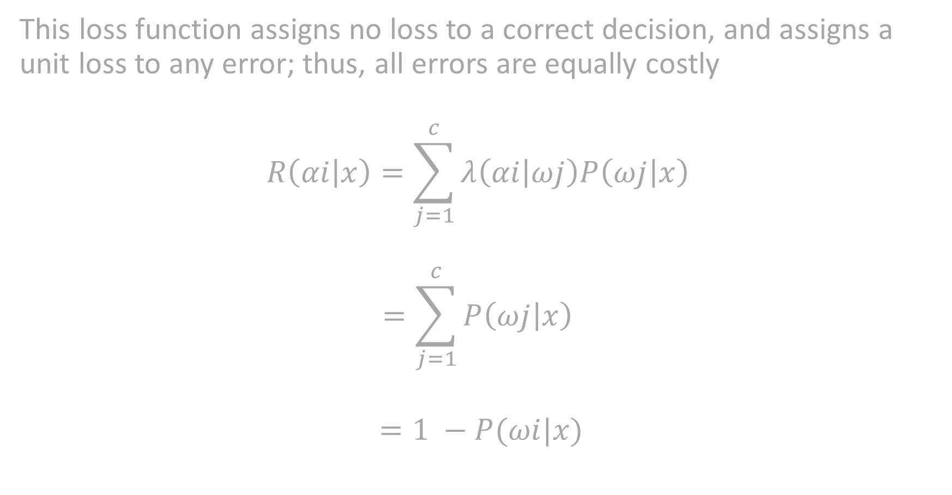
This loss function assigns no loss to a correct decision, and assigns a unit loss to any error; thus, all errors are equally costly
$$R\left(αi | x\right)=\sum_{j=1}^{c}{λ\left(αi | ωj\right)P\left(ωj | x\right) }$$
$$=\sum_{j=1}^{c}{P\left(ωj | x\right) }$$

Slide 14
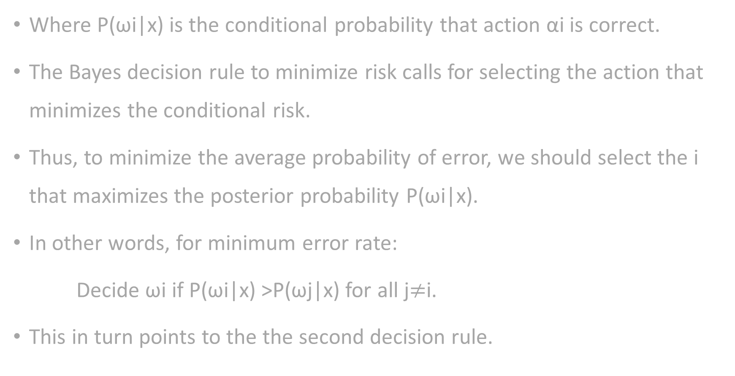
Where P(ωi|x) is the conditional probability that action αi is correct.
The Bayes decision rule to minimize risk calls for selecting the action that minimizes the conditional risk.
Thus, to minimize the average probability of error, we should select the i that maximizes the posterior probability P(ωi|x).
In other words, for minimum error rate:
Decide ωi if P(ωi|x) >P(ωj|x) for all j$≠$i.
This in turn points to the the second decision rule.

Slide 15
Minimax Criterion
MINIMUM ERROR RATE CLASSIFICATION
prior probabilities might vary widely and in an unpredictable way or we do not know the prior probabilities.
A reasonable approach is then to design our classiﬁer so as to minimize the maximum possible overall risk.

Slide 16
In order to understand this, we let R1 denote that region in feature space where the classiﬁer decides ω1 and likewise for R2 and ω2, and then write our overall risk in terms of conditional risks.
On resolution the equation shows that once the decision boundary is determined, the overall risk is linear in P(ω1).
ﬁnd a boundary such that the constant of proportionality is 0
then the risk is independent of priors.
This is the minimax solution and the minimax risk, Rmm.

Slide 17
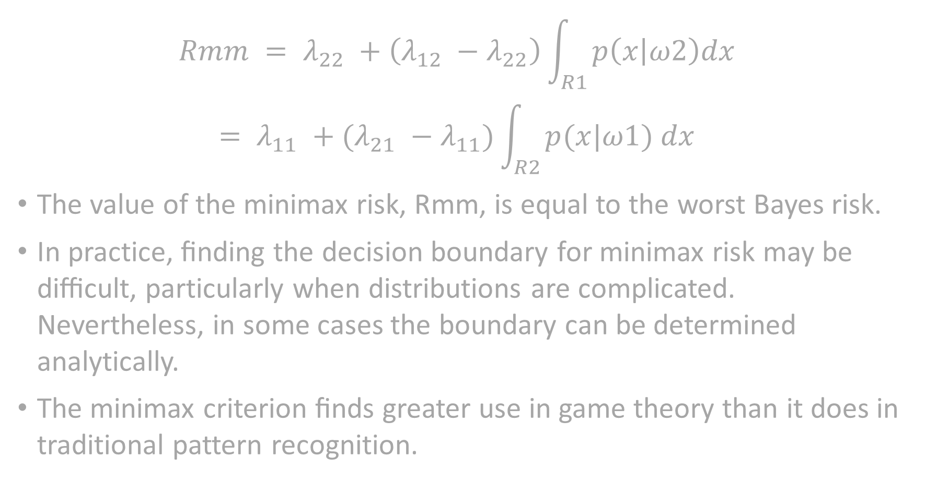
$$Rmm = λ_{22} +\left(λ_{12} −λ_{22}\right)\int_{R1}{p\left(x | ω2\right)dx }$$
$$= λ_{11} +(λ_{21} −λ_{11})\int_{R2}{p(x|ω1) dx }$$
The value of the minimax risk, Rmm, is equal to the worst Bayes risk.
In practice, ﬁnding the decision boundary for minimax risk may be diﬃcult, particularly when distributions are complicated. Nevertheless, in some cases the boundary can be determined analytically.
The minimax criterion ﬁnds greater use in game theory than it does in traditional pattern recognition.

Slide 18
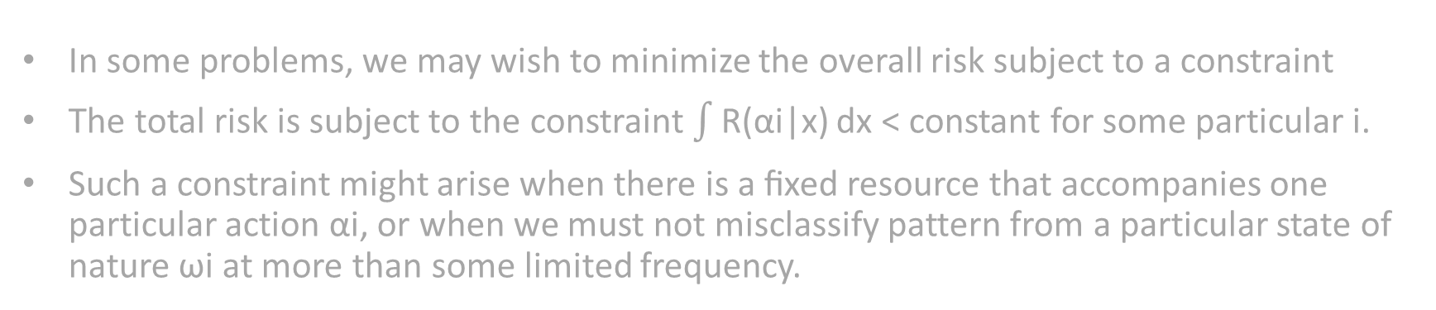
Neyman-Pearson Criterion
MINIMUM ERROR RATE CLASSIFICATION
In some problems, we may wish to minimize the overall risk subject to a constraint
The total risk is subject to the constraint $\int{\text{R}\text{(}\text{αi}\text{|}\text{x}\text{)}}$ dx < constant for some particular i.
Such a constraint might arise when there is a ﬁxed resource that accompanies one particular action αi, or when we must not misclassify pattern from a particular state of nature ωi at more than some limited frequency.

Slide 19
THANK YOU

